Slide 1
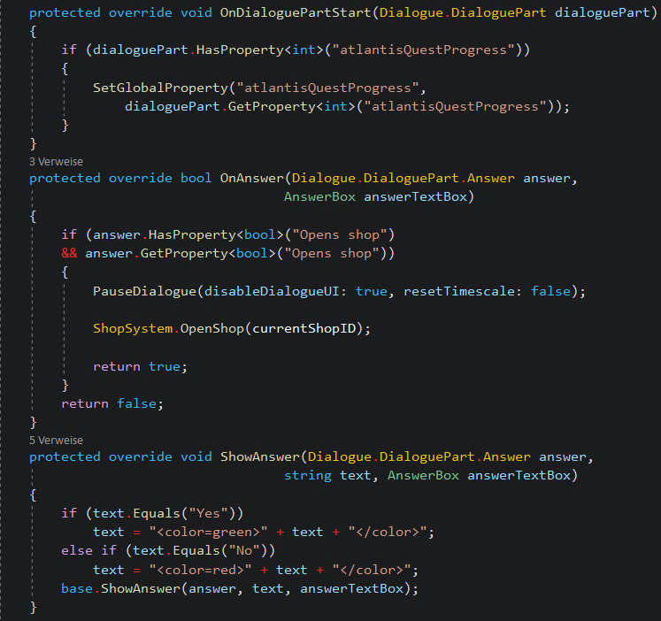
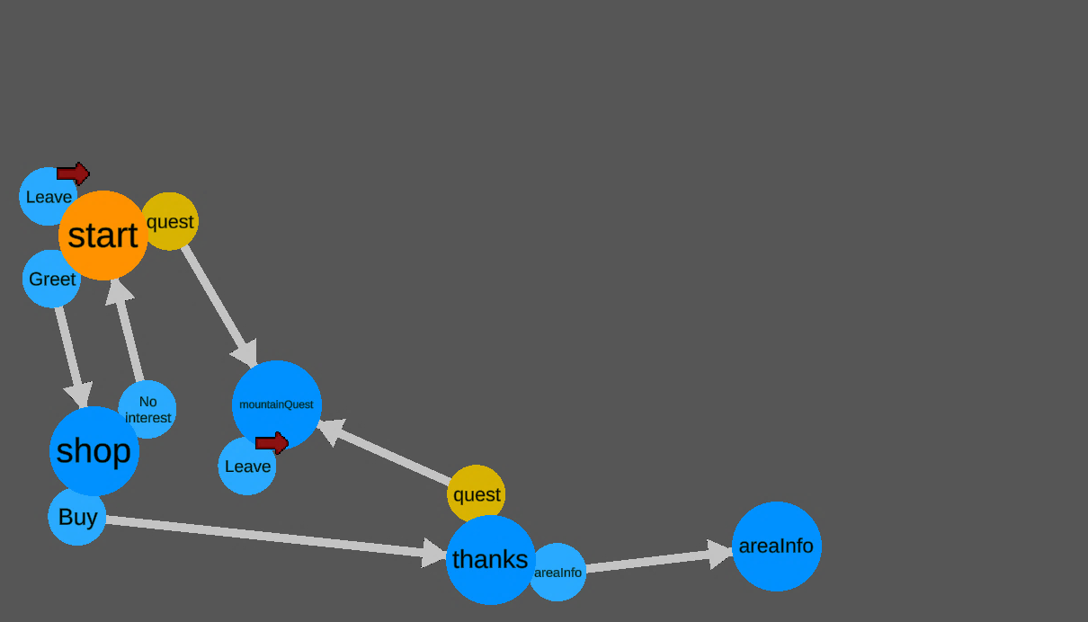


Slide 2
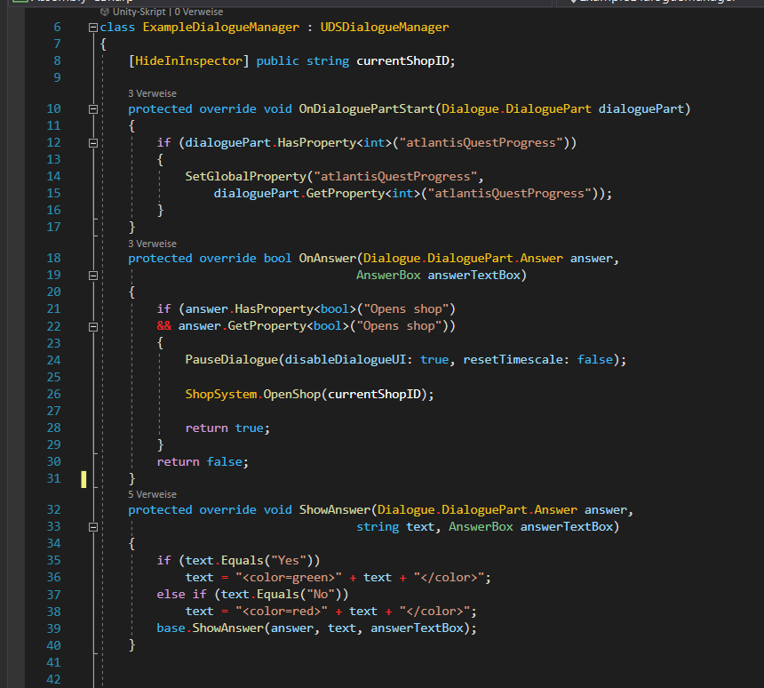

Slide 3
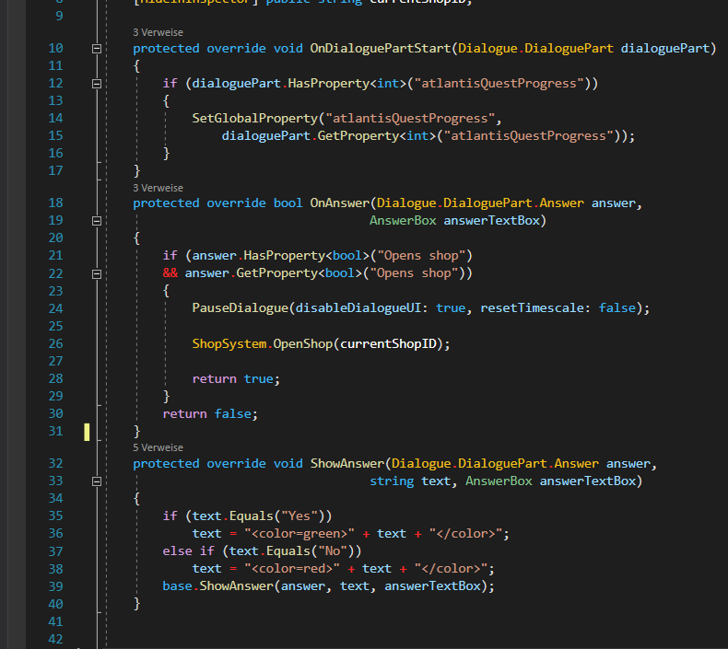

Slide 4
OnDialogueStart
EnableDialogueUI
OnDialoguePartStart
ShowDialoguePartText
OnShowCharacter
ShowName
ShowAnswer
OnAnswer
DisableDialogueUI
OnDialogueEnd

Slide 5
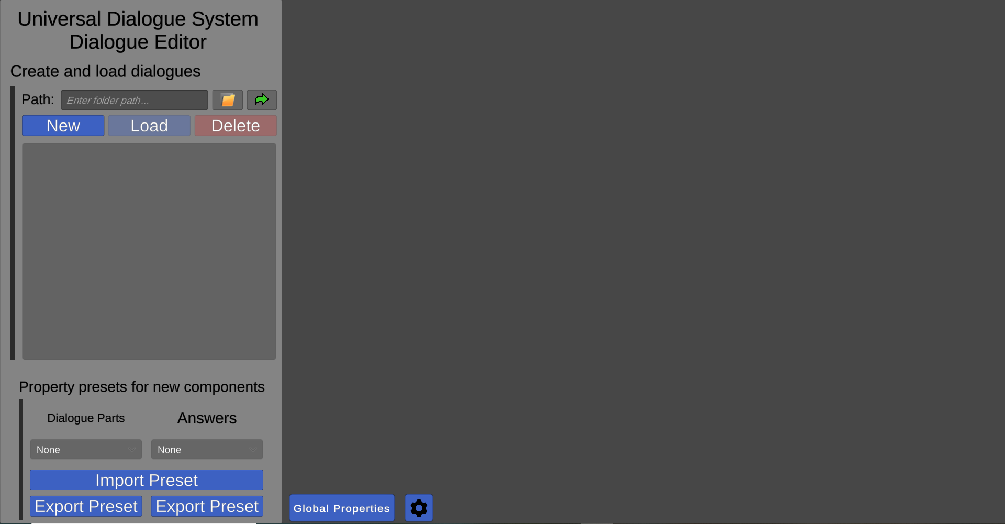
1
2
3

Slide 6
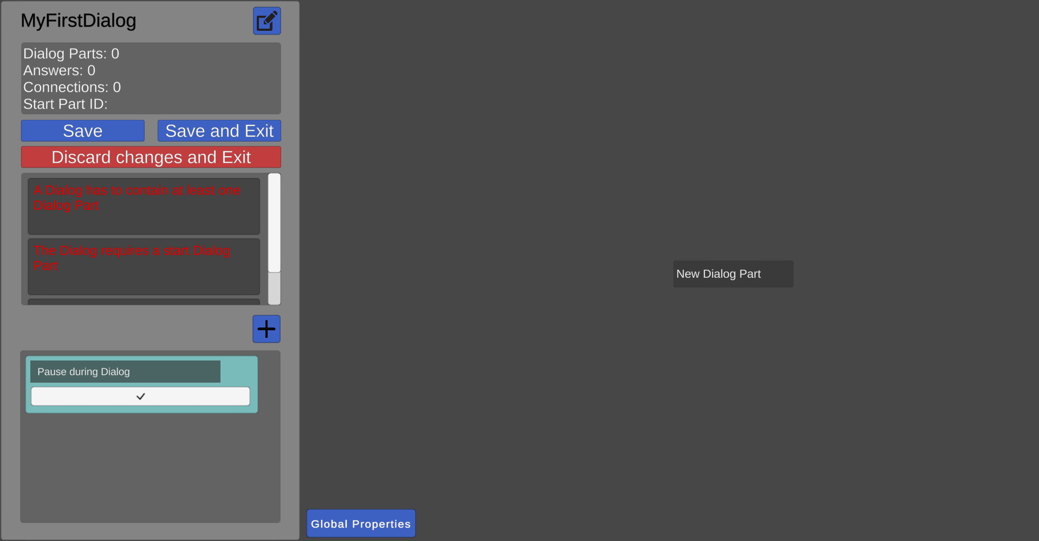
3
2
1

Slide 7
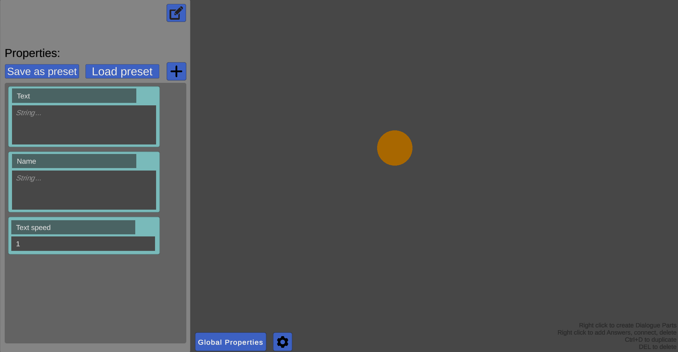
1
2
3

Slide 8
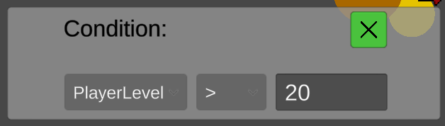
2
1
3

Slide 9
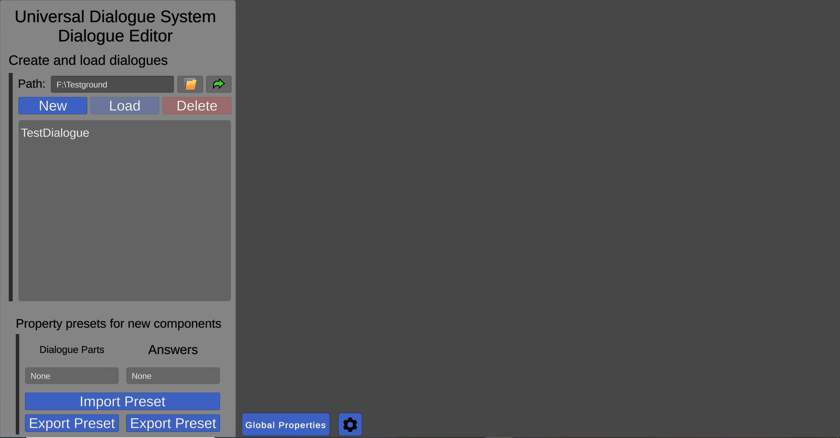
1
2
3

